Slide 1
Week 7
Alexey V. Zimin
JHU BME 580.417/707

Slide 2
Lab #4: Build K-unitigs from K-mers
Lab #4: Due Friday October 30. The goal for Lab #4 is to write code that parses reads in fastq file, counts canonical K-mers for a given K, and then builds K-unitigs – unique non branching paths of K-mers in a K-mer graph. K-unitigs are genomic sequences. All K-mers in the reads must be present in K-unitigs. Each K-mer of size K must be in only one K-unitig.
Reads are provided in autograder as “read1.fq”. You can assume that this file is in your current directory. Reads are also available on github for testing: https://github.com/alekseyzimin/BME-Algorithms-for-Analysis-of-Genomic-Data/raw/refs/heads/main/read1.fq
Write the following functions in python:
  (g:10/u:10) reverse_complement(seq) – returns reverse complement of sequence seq
  (g:10/u:10) canonical_kmer(kmer) – returns canonical version of the k-mer kmer using lexicographic order
  (g:10/u:20) count_canonical_kmers(file.fastq,k) – reads genome sequences from file.fastq, returns dictionary kmer_counts[kmer]=count for K-mer size k
  (g:10/u:20) compute_n50(sequences) -- returns N50 of sequences in the input array sequences
  (g:40/u:40) build_unitigs(kmer_counts) – returns array of k-unitig sequences, argument is dictionary kmer_counts produced by count_canonical_kmers
Graduate section only(g:20): run compute_n50(build_unitigs(count_canonical_kmers(fastq_path,k))) code varying K-mer size between 15 and 90, and submit a plot of how K-unitigs N50 varies with K. At which K value the N50(K) is the largest? Add the value in a text box to the plot.

Slide 3
K-unitigs
K-unitigs are uniquely assemble-able paths of K-mers connected with K-1 exact overlaps
Paths must not contain any branches in forward or reverse direction
Pick a canonical K-mer, extend uniquely forward and backward checking for branches
  Do you need to check if K-mer has been used in a path before?
Stop extension and save the sequence if a forward or backward branch detected

Slide 4
Why choose an odd value of K?
We usually choose an off value of K for k-mer graph
The reason is that we want to avoid scenario when k-mer == its reverse complement, because in this case graph walk can potentially jump strands
Example:
rc(ATATAT) is ATATAT
rc(ATATA) is TATAT

Slide 5
K-mer graph
Let’s build 5-mer graph, 5-mers are nodes and 6-mers are edges. Start with AGACA,check continuations in both directions
AGACA
none A A -none
none C C 5
none G G 10
15 T T -none

Slide 6
K-mer graph
Let’s build 5-mer graph, 5-mers are nodes and 6-mers are edges. Start with AGACA,check continuations in both directions
GACAC
AGACA
GACAG none A
This is a forward “branch”. Stop extending AGACA forward and go backward.

Slide 7
K-mer graph
Let’s build 5-mer graph, 5-mers are nodes and 6-mers are edges. Start with AGACA,check continuations in both directions
GACAC
AGACA
none A GACAG
none C
none G
15 T none A

Slide 8
K-mer graph
Let’s build 5-mer graph, 5-mers are nodes and 6-mers are edges. Start with AGACA,check continuations in both directions
GACAC
TAGAC AGACA
we can collapse the unique edge GACAG
none Acolla
Possibly unique continuation? Check backward edges of the next k-mer (TAGAC) for possible backward branch

Slide 9
K-mer graph
Let’s build 5-mer graph, 5-mers are nodes and 6-mers are edges. Start with AGACA,check continuations in both directions
GACAC
TAGAC AGACA
we can colnone C GACAG
none G
none T
none Acolla
Possibly unique continuation? Check backward edges of the next k-mer (TAGAC) for possible backward branch

Slide 10
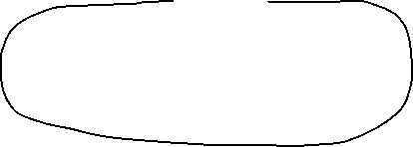
K-unitigs
This graph contains five K-unitigs (black lines)
K-1 overlap
K-1 overlap

Slide 11
Evaluating genome assemblies: size
Most eukaryotic genomes are diploid or polyploid:
  One chromosome from each parent
Estimated genome size is typically counting each chromosome ONCE
  Human genome size is ~3.2G bp
Traditional pseudo-haploid genome assembly is a mosaic of two haplotypes
Total sequence in the assembly:
  << Estimated genome size: incomplete assembly, possibly due to insufficient sequencing depth, collapsed repeats, elimination of short contigs
  >>Estimated genome size: redundant assembly, possibly due to extra haplotype variants for heterozygous diploid/polyploid genomes

Slide 12
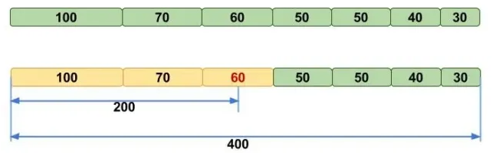
Evaluating genome assemblies: N50
N50 metric: the length of the shortest contig (scaffold) for which longer or equal length contigs (scaffolds) contain at least 50% of the total assembly
NG50 -- N50 that uses estimated genome size instead of assembly size
Image credit: molecularecologist.com

Slide 13
Note about N50
N50 may be unstable when there are only few big contigs in the assembly. For example, for 100Kb genome:
  55,25,20 yields N50 of 55
  40,35,25 yields N50 of 35
When comparing two assemblies’ N50s, one must use the same assembly size. Using smaller assembly size boosts N50:
  Contigs:
  70, 60, 50, 30, 20, 10, 10,10, 5, 5, 5, 5 sum=280
  N50(G=280)=50, N50(G=260)=60
Use NG50 – N50 with a fixed G (genome size). NG50 is fair when comparing two assemblies of the same organism

Slide 14
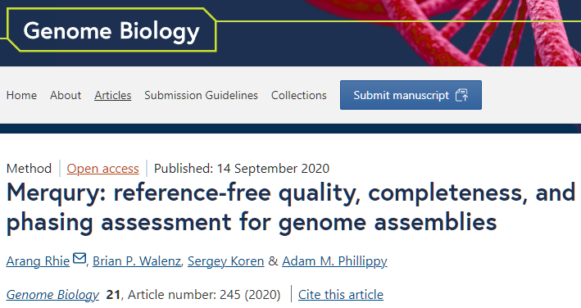
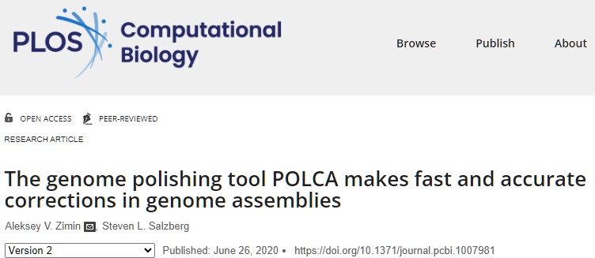
Evaluating genome assemblies: error rate
Consensus error rate can be estimated by aligning accurate reads from the same organism to the assembly
Can use the original reads
Suitable reads: Illumina and PacBio HiFi
Can use alignment-based approach (POLCA) or k-mer based approach (Merqury)

Slide 15
K-unitig algorithm
ATG 1
TGA TCA 1
ATC 1
(a,,,)TG(a,,,) -> ATGA(a,c,g,t)
(a,c,g,t)ATG
ATC
For b in [ACGT]:
  Continuation_f=suffix+b
  Continuation_b=b+suffix
  If(canonical_kmer(

Slide 16
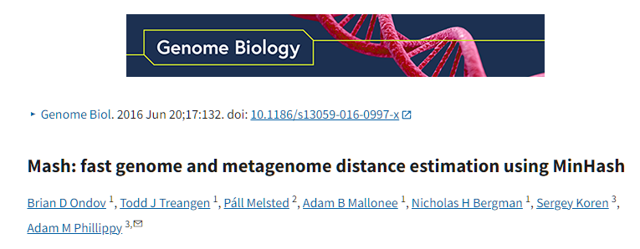
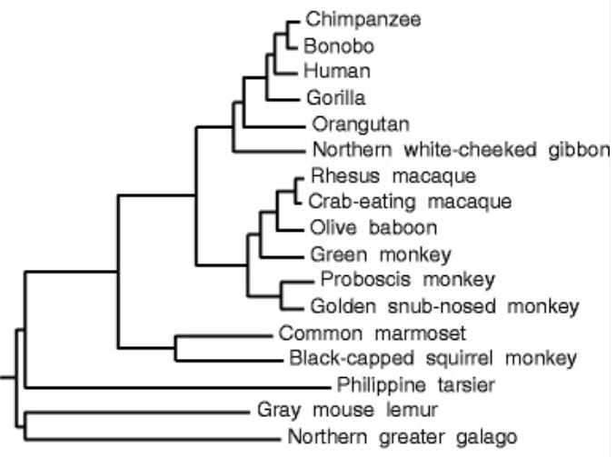
Similarity of genomes
There are many assembled genomes available
Can we figure out how similar two genomes are?
Can use alignment, but what if we have 1000’s of genomes?
Can use Jaccard similarity index!

Slide 17
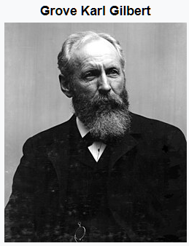
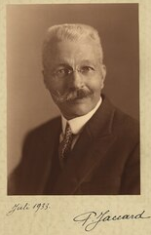
Jaccard similarity index
The Jaccard index is a statistic used for gauging the similarity and diversity of sample sets. It is defined in general taking the ratio of two sizes (areas or volumes), the intersection size divided by the union size, also called intersection over union (IoU).
It was developed by Grove Karl Gilbert in 1884 as his ratio of verification and now is often called the critical success index in meteorology.
It was later developed independently by Paul Jaccard, originally giving the French name coefficient de communauté (coefficient of community)
Images credit: wikipedia

Slide 18
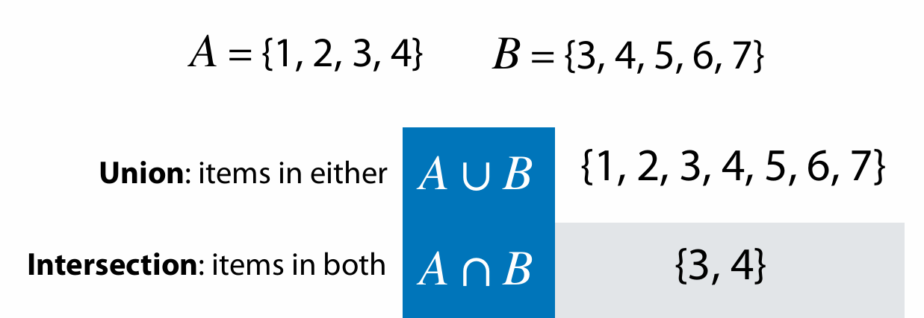
Sets
Adapted from Ben Langmead https://www.cs.jhu.edu/~langmea/resources/lecture_notes/140_similarity_pub.pdf

Slide 19
Cardinality
Cardinality if a set A = {1,2,3,5} or |A| is the number of distinct elements in the set
|{1,1,2,3,3}|=3
If a set is treated as multiset, then cardinality is simply the number of elements:
  For multiset {1,1,2,2,3,3} cardinality is 6
We will not be using multisets

Slide 20
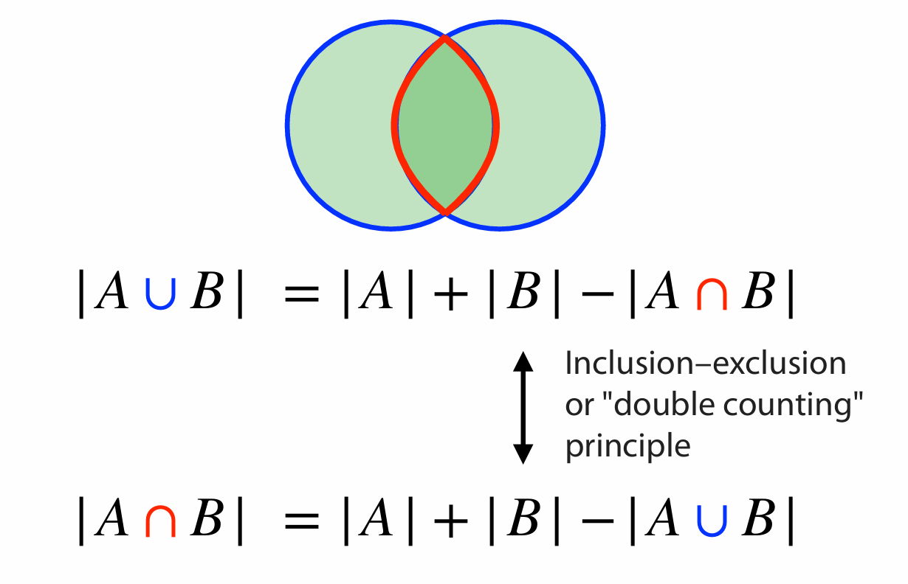
Sets
Adapted from Ben Langmead https://www.cs.jhu.edu/~langmea/resources/lecture_notes/140_similarity_pub.pdf

Slide 21
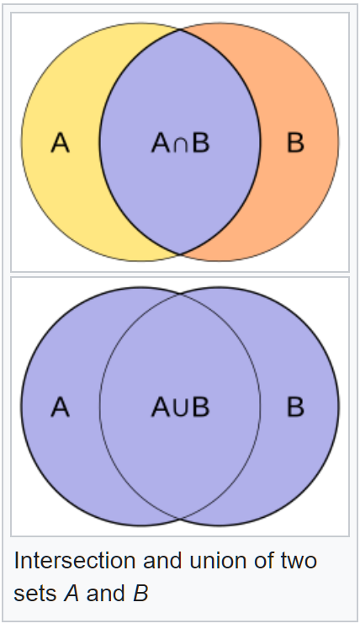


Jaccard index (or coefficient)
The Jaccard index is a statistic used for gauging the similarity and diversity of sample sets. It is defined as the intersection size divided by the union size, also called intersection over union (IoU):
$$J\left(A,B\right)=\frac{\left|A\bigcap{B} \right|}{\left|A\bigcup{B} \right|}$$

Slide 22
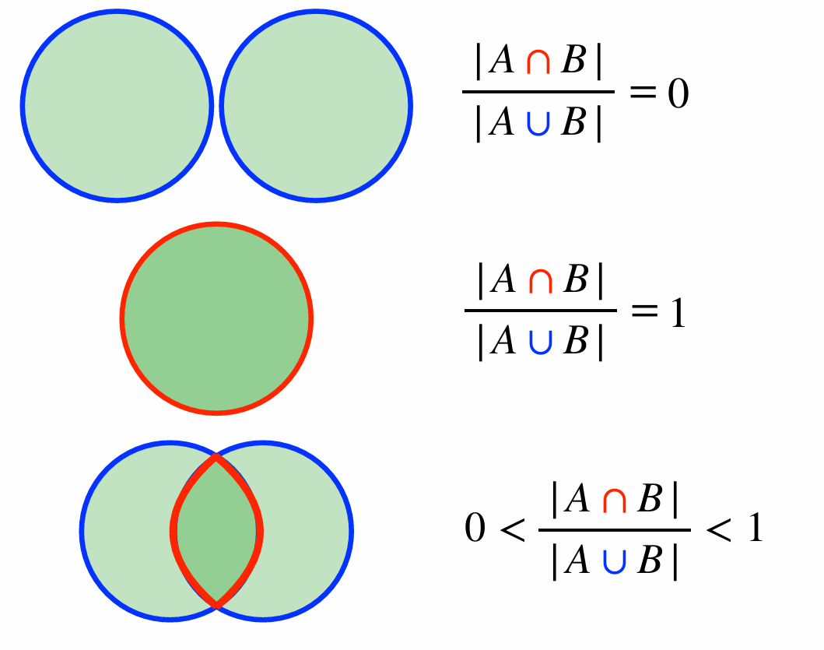
Jaccard coefficient
Adapted from Ben Langmead https://www.cs.jhu.edu/~langmea/resources/lecture_notes/140_similarity_pub.pdf

Slide 23
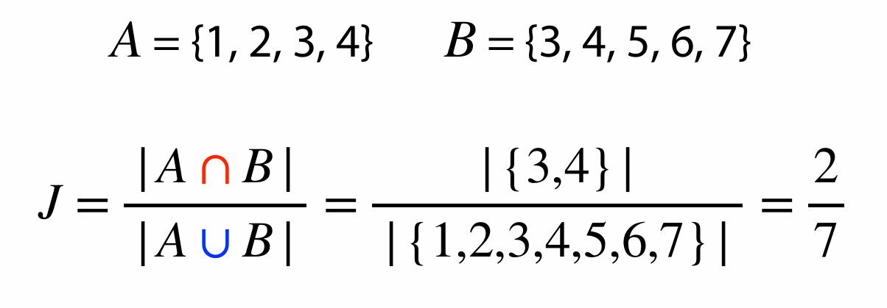
Jaccard coefficient
Adapted from Ben Langmead https://www.cs.jhu.edu/~langmea/resources/lecture_notes/140_similarity_pub.pdf

Slide 24

Jaccard index for genome similarity/alignment
Have genomes A and B
Get all canonical K-mers from A and B
Jaccard similarity can be computed from distinct K-mer sets in A and B
Hash each K-mer to an integer h(k)
K-mer sets could be large
Can use sets of distinct minimizers M(A) and M(B):
$$J(A,B)=\frac{\left|M(A)\bigcap{M(B)} \right|}{\left|M(A)\bigcup{M(B)} \right|}$$

Slide 25
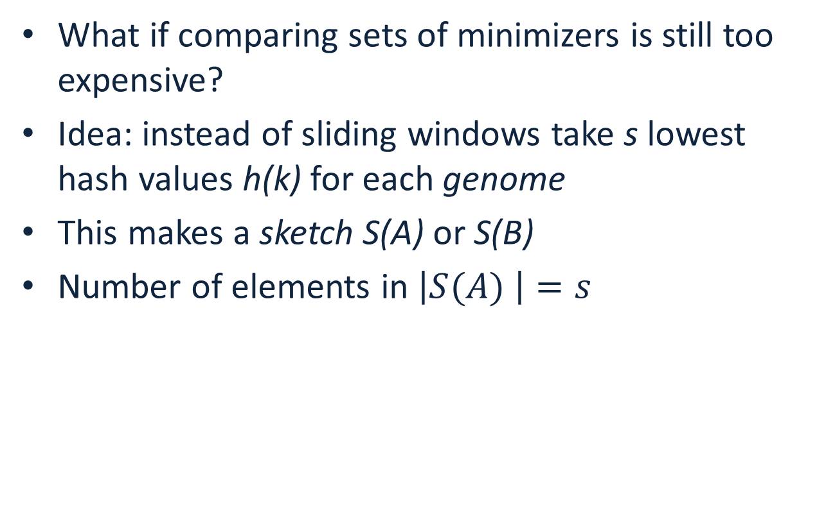
Jaccard index for genome similarity/alignment
What if comparing sets of minimizers is still too expensive?
Idea: instead of sliding windows take s lowest hash values h(k) for each genome
This makes a sketch S(A) or S(B)
Number of elements in $\left|S(A) \right|=s$
$$J(A,B)≈\frac{\left|S(A)\bigcap{S(B)}\right|}{\left|S(A)\bigcup{S(B)} \right|}≈\frac{\left|S(A\bigcup{B)}\bigcap{S(A)\bigcap{S(B)}}\right|}{\left|S(A\bigcup{B)}\right|}$$

Slide 26
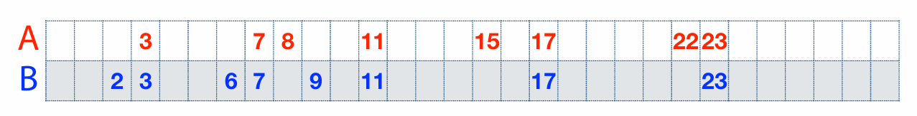
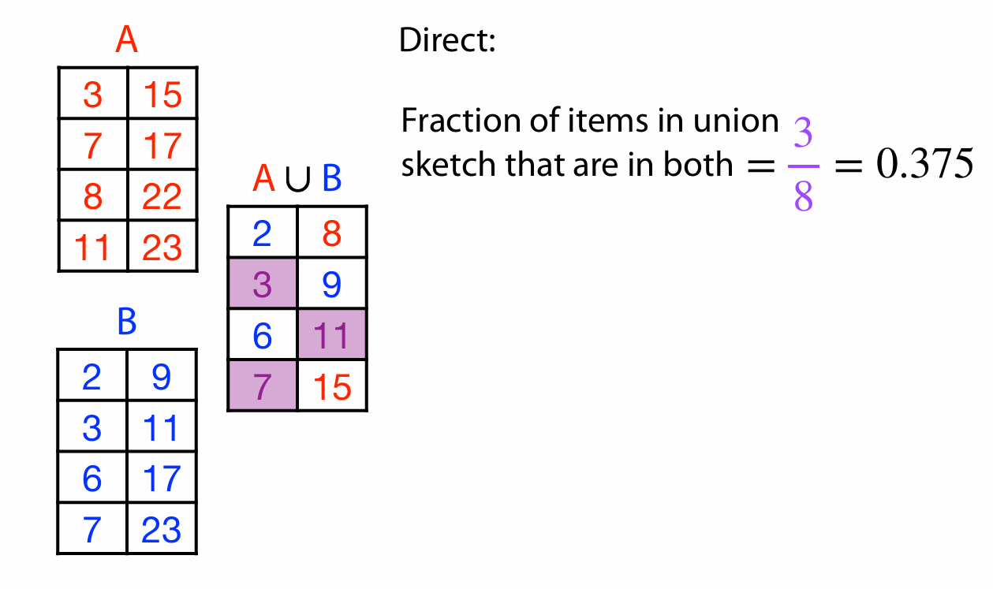
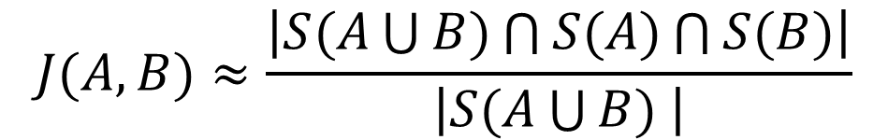
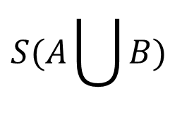


Another example
$$S(A)$$
$$S(A\bigcup{B)}$$
$$S(B)$$
$$J(A,B)≈\frac{\left|S(A\bigcup{B)\bigcap{S(A)}\bigcap{S(B)}}\right|}{\left|S(A\bigcup{B) }\right|}$$

Slide 27
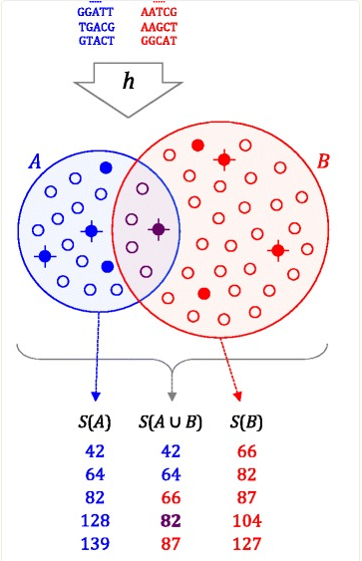

Genome distance estimation using MinHash
Reduce each genome to a MinHash(G), a set of s integers (typically 500-10000)
Compare MinHashes (sort)
$$J(A,B)≈\frac{\left|S(A\bigcup{B)\bigcap{S(A)}\bigcap{S(B)}}\right|}{\left|S(A\bigcup{B) }\right|}$$

Slide 28
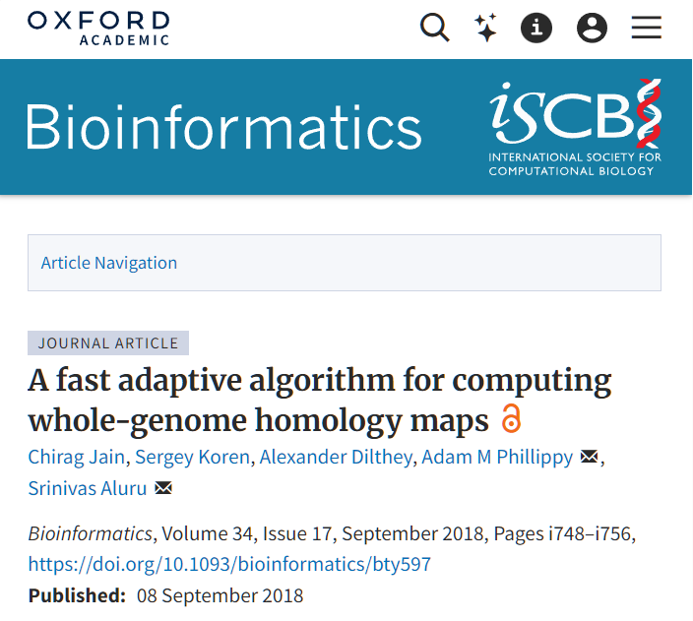
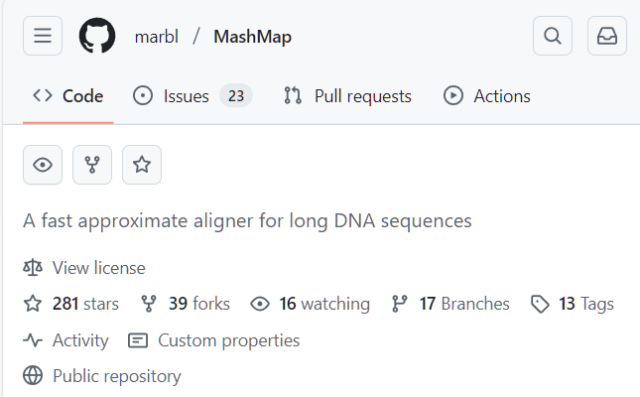
Computing approximate alignments with MinHash
Can store genome positions of k-mers in the MinHash
Compute approximate alignments as clusters of shared k-mers
Requires bigger MinHash size s
Implemented in MashMap software

Slide 29
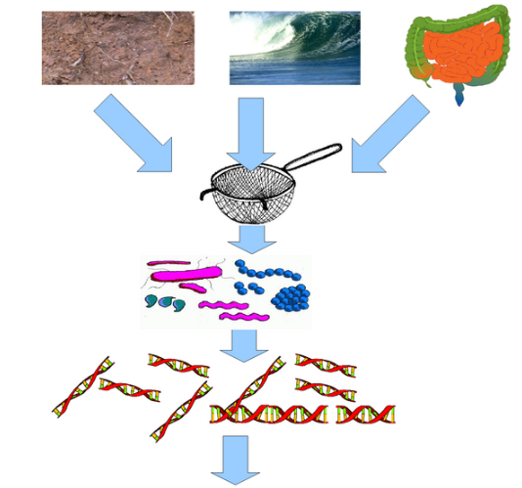

Metagenomic data analysis
In a typical genome project you want to sequence DNA from a single organism
Metagenomic data is sequenced from a sample intentionally containing many species (many of them unknown)
Important for studying composition of microorganisms (bacteria of fungus), diagnostics of diseases

Slide 30
Characteristics of metagenomic data
Typically short reads (Illumina)
Number of species: unknown
Coverage of each species: unknown
Assembly possible? Maybe, but similar species can assemble together forming chimeric contigs
Preferred mode of analysis: K-mers

Slide 31
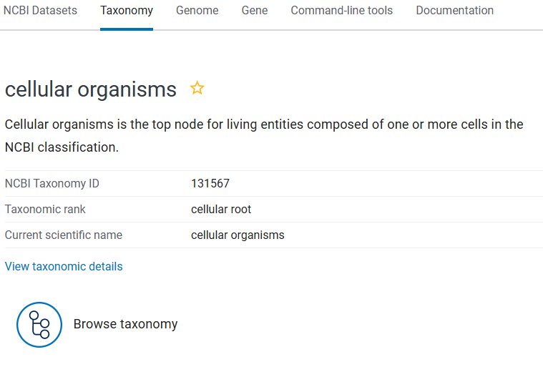
NCBI Taxonomy
The Taxonomy Database is a curated classification and nomenclature for all organisms in the public sequence databases.
This currently represents about 10% of the described species of life on the planet.
All known species are part of NCBI Taxonomy tree. Each node on the tree has a numerical ID

Slide 32
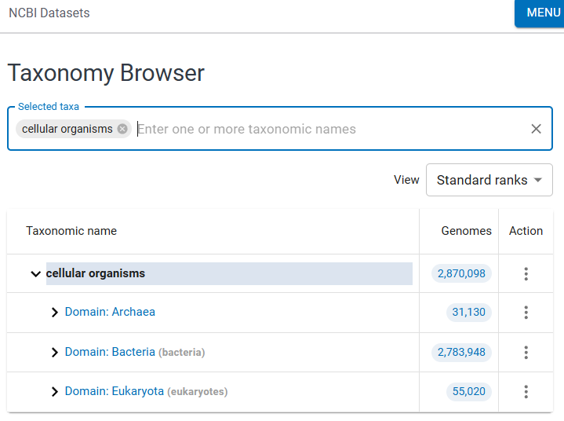
NCBI Taxonomy Browser
By browsing the taxonomy tree one can find all known species, their ID and known evolutionary relationships
DEMO

Slide 33
Analysis of metagenomic data
High resolution: KrakenUniq:
  Build database of all k-mers in a set of species to be classified
  Attach Taxonomic ID to each K-mer
    Use the lowest common ancestor’s ID
  Examine all k-mers in reads from metagenomic sample
  Determine what Tax IDs are present
Databases are BIG!

Slide 34
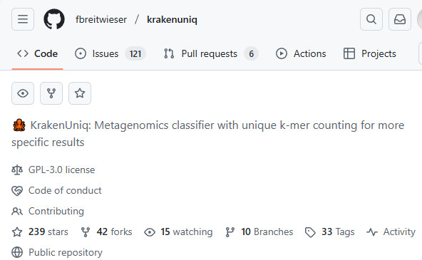
Analysis of metagenomic data
High resolution: KrakenUniq:
  Build database of all k-mers in a set of species to be classified
  Attach Taxonomic ID to each K-mer
    Use the lowest common ancestor’s ID
  Examine all k-mers in reads from metagenomic sample
  Determine what Tax IDs are present
Databases are BIG!

Slide 35
Analysis of metagenomic data
WARNING! Contamination!
  Species detected != It is in the sample
    Lab contamination
    Illumina sequencing chemicals have contaminants in them
    Sample collection contamination
  Can run control sample to eliminate contamination

Slide 36
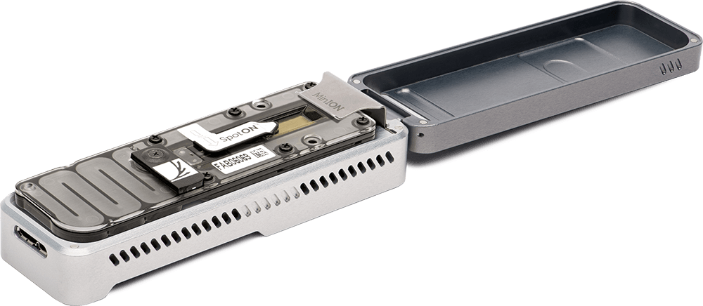
Long-read metagenomics
Long read sequencing is getting cheaper -> can use them for metagenomic samples
ONT MinION is portable – can take it into the field
Each read yields more K-mers
Create database of sketches or minimizers in genomes
  Use minimizers with large window size – number or minimizers proportional to each genome size, or
  Use fixed size sketches
Assign the Tax ID of the lowest common ancestor to each K-mer

Slide 37
Making sense of genomic sequence
We assembled the genome – what is next?
We can identify functionally important elements (subsequences):
  Genes
  Protein coding regions
  Regulatory elements
  This is called genome annotation
Genome annotation provides coordinates (start, stop and strand) and identifies function of functional elements in the genomic sequence

Slide 38
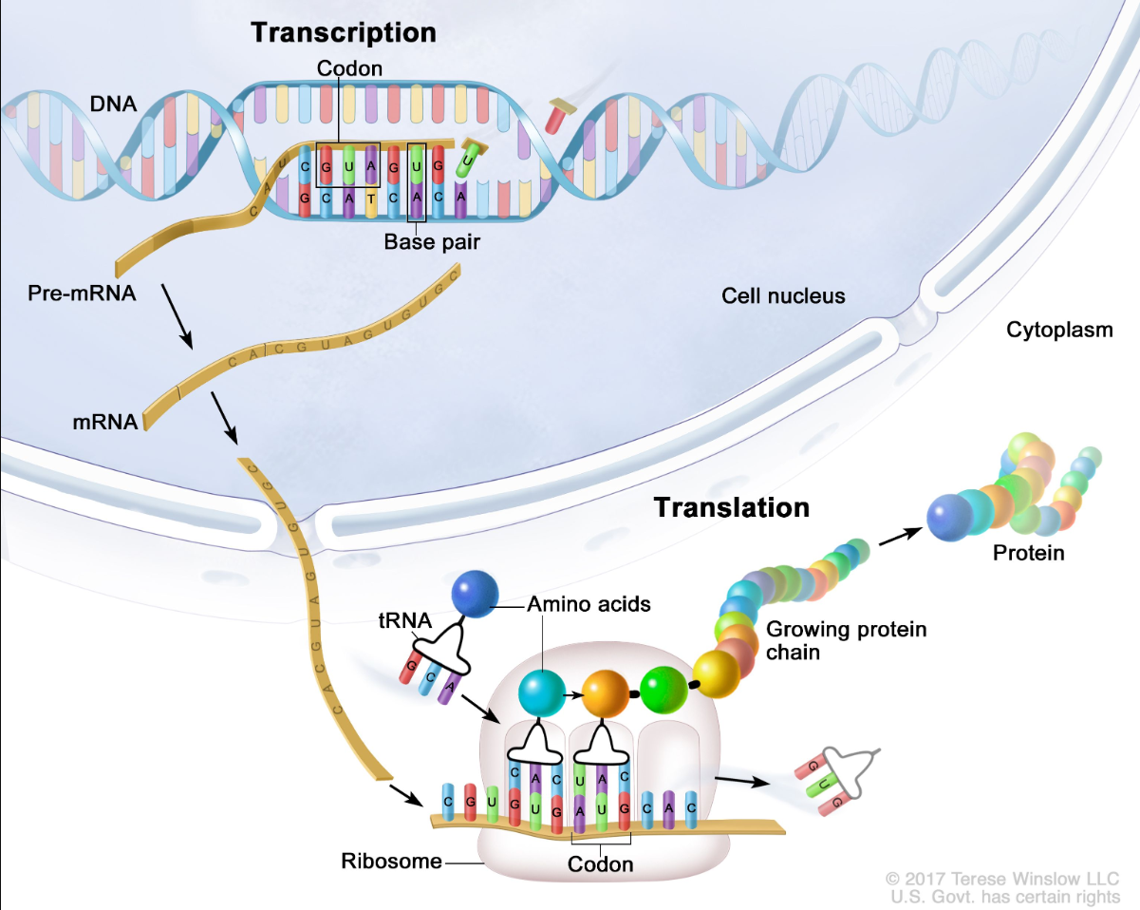
How transcription + translation works?
Transcription and translation are processes a cell uses to make all proteins the organism needs to function from information stored in the sequence of bases in DNA
Pre-mRNA has introns
mRNA has introns spliced out
Transcript is mRNA with U’s replaced by T’s
Notes:
Transcription and translation are processes a cell uses to make all proteins the body needs to function from information stored in the sequence of bases in DNA. The four bases (C, A, T/U, and G in the figure) are the building blocks of DNA and RNA. During transcription, a piece of DNA that codes for a specific gene is copied into messenger RNA (mRNA) in the nucleus of the cell. The mRNA then carries the genetic information from the DNA to the cytoplasm, where translation occurs. During translation, proteins are made using the information stored in the mRNA sequence. The mRNA attaches to a structure called a ribosome that can read the genetic information. As the mRNA passes through the ribosome, another type of RNA called transfer RNA (tRNA) carries a protein building block called an amino acid to the ribosome. The tRNA carrying the amino acid binds to a matching sequence in the mRNA. As each tRNA binds to the mRNA strand, the amino acid it carried joins with the other amino acids to form a chain of amino acids. Once all of the amino acids coded for in the piece of mRNA have been linked, the completed protein is released from the ribosome.

Slide 39
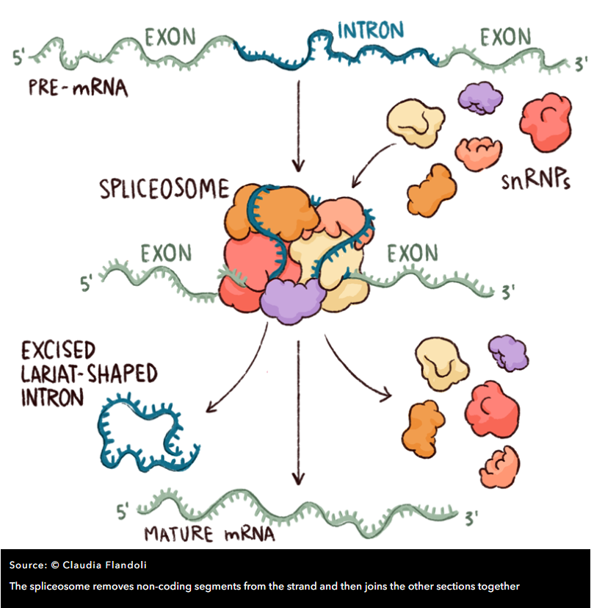
Splicing
Spliceosome includes five so-called ‘small nuclear ribonucleoproteins’ (snRNPs, often pronounced ‘snurps’) and numerous associated proteins.
The snRNPs contain RNA that is rich in Uracil, the RNA base that replaces DNA’s Thymine, and they are named – perhaps unimaginatively – U1, U2, U4, U5 and U6
Spliceosome determines the start and end of an intron by detecting DNA patterns around donor (typically GT) and acceptor (typically AG) sites

Slide 40
Poly-A tail
The poly-A tail is a long chain of Adenine nucleotides that is added to a messenger RNA (mRNA) molecule during RNA processing to increase the stability of the molecule
Processing of the 3' end adds a poly-A tail to the RNA molecule that is between 100 and 250 A’a long
Poly-A tail allows the mature messenger RNA molecule to be exported from the nucleus and translated into a protein by ribosomes in the cytoplasm

Slide 41
How transcripts are obtained
Two methods
  Ribosome depletion (ribo-zero)
  Poly-A capture
Dominant method is Poly-A capture (EST, RNA-Seq, Iso-Seq,ONT sequencing)
  Reads mature transcripts with introns spliced out
  Requires fresh good quality RNA
  Good for transcriptome assembly
Ribo-zero can be used for degraded RNA
  OK for quantification
  Bad for transcriptome assembly

Slide 42
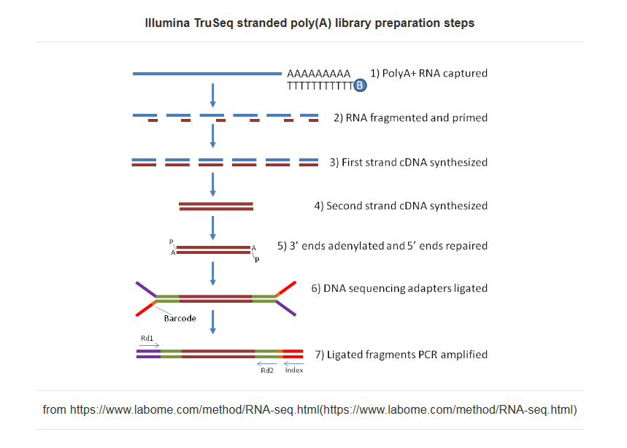
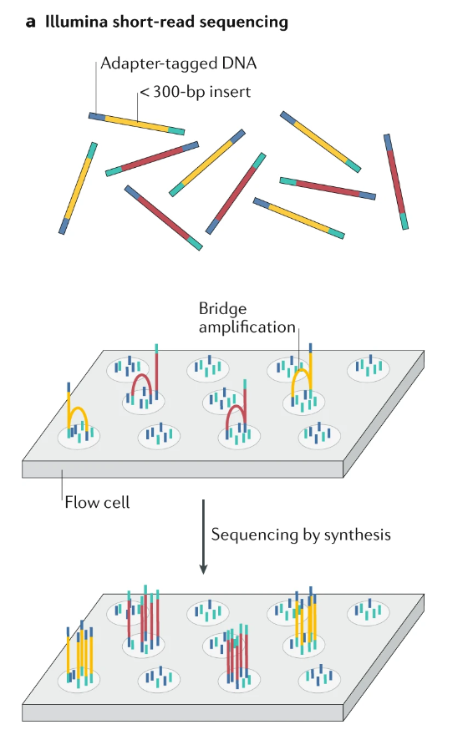
Short read Illumina RNA-seq
and Logsdon GA, Vollger MR, Eichler EE. Long-read human genome sequencing and its applications. Nature Reviews Genetics. 2020 Oct;21(10):597-614.

Slide 43
Transcript
Transcripts are sequences of exons after the introns are spliced out:
genome
exon1 exon2 exon3
transcript
exon1 exon2 exon3
UTRs are UnTRanslated sequences before and after the protein coding region
Protein CoDing Sequence (CDS) starts with a start codon (ATG) and ends with a stop (TAG, TAA, or TGA) for eukaryotic genomes
ATG…
…TAA
3’ UTR
3’ UTR
5’ UTR
ATG…
…TAA
3’ UTR
3’ UTR

Slide 44
Gene
Gene is a locus on the genome containing one or more transcripts
Multiple transcripts per gene are possible due to alternative splicing
Gene starts at the start of the leftmost transcript and ends at the end of the rightmost transcript. All transcripts in a gene are on the same strand
Gene 1
intron1
intron2
exon1
GT
AG
exon2
GT
AG
exon3
Transcript 1
intron3
exon1
GT
AG
exon4
Transcript 2

Slide 45
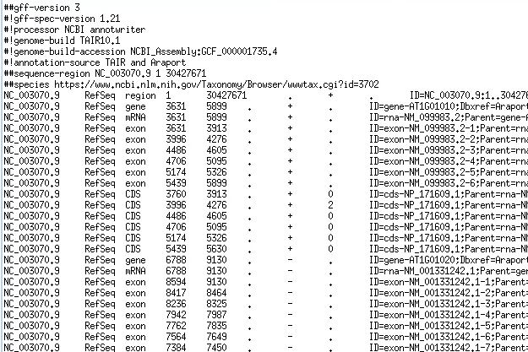
GFF/GTF files provide a map for all known genome features
Column | Description
Seqname | Name of chromosome, scaffold or contig
Source | Name of the datasource
Feature | Feature type (e.g. gene, exon, transcript, CDS, five_prime_UTR)
Start | Start position of the feature
End | End position of the feature
Empty | ‘.’
Strand | Defined as + (forward) or - (reverse)
Frame | Either ‘0’, ‘1’, or ‘2’ - indicating reading frame by base position
Attribute | A semicolon separated list of other info about the feature
GFF has many versions, but the two most popular are:
GTF2 (Gene Transfer Format): https://mblab.wustl.edu/GTF2.html
GFF3 (Generic Feature Format): https://github.com/The-Sequence-Ontology/Specifications/blob/master/gff3.md

Slide 46
Gene representation
gene
transcript or mRNA
…
transcript or mRNA
exon
exon
exon
exon
exon
5’ UTR
5’ UTR
5’UTR
CDS
CDS
CDS
3’ UTR
Start codon (ATG)
Stop codon (TAA,TAG,TGA)

Slide 47
Spliced alignment
We find transcripts on the genome by spliced alignment of transcriptome reads

Slide 48
Variant Calling
Sequencing: A DNA sample is sequenced to generate a large number of short reads containing genetic information.
Alignment: The generated short reads are aligned (mapped) to a known reference genome.
Variant Identification: Bioinformatic algorithms compare the aligned reads to the reference to identify positions where they differ, indicating a variant.
Variant Call Formatting: The identified variants are compiled into a standardized Variant Call Format (VCF) file.

Slide 49
Types of variants
Single Nucleotide Variants (SNVs): A change in a single DNA base pair, such as a single nucleotide polymorphism (SNP).
Insertions/Deletions (Indels): Short segments of DNA that are inserted or deleted.
Structural Variants (SVs): Larger-scale changes to the genome, including deletions, duplications, inversions, and translocations.

Slide 50
Why variant calling is important
Disease Research: Variant calling helps identify genetic mutations associated with various diseases, including cancer.
Clinical Diagnostics: It provides data for diagnosing genetic conditions and understanding individual predispositions to common health problems.
Evolutionary Studies: Comparing variants across populations helps researchers understand evolutionary relationships and genetic diversity.

